Slide 1
Biodiversity for the national parks
Weston Eckloff

Slide 2
Breakdown
This project is broken down into two segments:
Data Analysis on the conservation status of the different species that live within the national parks.
Data Analysis on the sheep population of the parks and how much they are effected by foot & mouth disease.

Slide 3
Endangered Species

Slide 4
Protected Species data
The data from in the file, species_info.csv provided information for the following:
category – The classification of the animal(s) listed in the data table, broken down into “Mammal”, “Bird”, “Reptile”, “Amphibian”, “Vascular Plant” and “Nonvascular plant”.
scientific_name – The official binominal nomenclature of the animal(s) described.
common_names – The common names of the animal(s) derived from the scientific name column.
Conversation_status – The value of the conversation status of the species in question, broken down into “Species of Concern”, “Threatened”, “Endangered”, “In Recovery”.
While there are 5,824 records of species, in total there are only 5,541 unique species living in the National Parks.

Slide 5
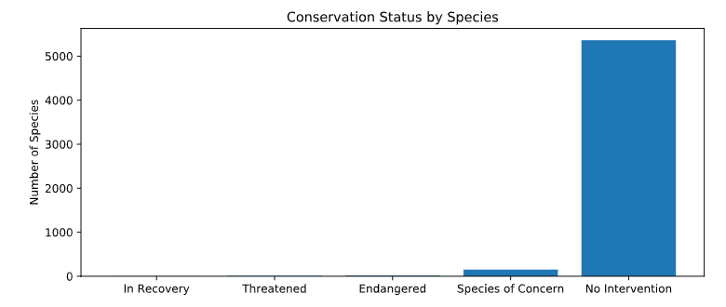
Conservation Status amongst species
Conservation Status | Total
In Recovery | 4
Threatened | 10
Endangered | 15
Species of Concern | 151
No Intervention | 5,363
As shown by the data above, a high majority of the species listed in the data table requires no protection.
Meanwhile, 151 are of concern and 25 others are in danger of becoming extinct in the future.

Slide 6
Are Certain Types of Species more likely to be endangered?
Category | Not Protected | Protected | Total | % Protected
Amphibian | 72 | 7 | 79 | 8.86
Bird | 413 | 75 | 488 | 15.37
Fish | 115 | 11 | 126 | 8.73
Mammal | 146 | 30 | 176 | 17.04
Nonvascular Plant | 328 | 5 | 333 | 1.50
Reptile | 73 | 5 | 78 | 6.41
Vascular Plant | 4,216 | 46 | 4,262 | 1.08
After applying the conservation category breakdown in the previous slide to the category of the species, the following conclusions can be made:
Both Nonvascular and Vascular plants require little to no intervention of protection.
Reptiles and Amphibians require a moderate amount of intervention of protection.
Birds and Mammals require the most of amount of protection amongst the park species.

Slide 7
SIGNIFICANCE?
Overall, Birds and Mammals are found more likely to be endangered than the other categories of species within the parks.
The question to ask now is:
Is the difference among the categorical data significant?
To solve this, a Chi-Squared test will be conducted.

Slide 8
CHI-SQUARED TESTS
Null Hypothesis #1
There is no significant difference between the mammal dataset and the bird dataset.
Null Hypothesis #2
There is no significant difference between the mammal dataset and the reptile dataset.
In order to reject the null hypothesis, the p-value generated from the Chi-Squared contingency test must be less than 0.05. That shows we have a 95.0+% confidence that the null hypothesis can be rejected and show statistical significance.

Slide 9
CHI-SQUARED TESTS
Mammals vs. Birds
Mammals vs. Reptiles
 | Protected | Not Protected | P-Value | Significant?
Mammal | 30 | 146 | 0.68759 | No
Bird | 75 | 413
 | Protected | Not Protected | P-Value | Significant?
Mammal | 30 | 146 | 0.03836 | Yes
Reptile | 5 | 73

Slide 10
Conclusion
We can reject Null Hypothesis #1 because the p-value is remarkably greater than 0.05 and it shows the difference between the mammals and birds is by chance.
However, we can accept Null Hypothesis #2 because the p-value is less than 0.05. There is an estimated 96.2% confidence that the difference between mammals and reptiles is significant.
RECOMMENDATION: The conservationists of the parks should dedicate time and effort into protecting the mammals and the birds as they are more likely to become endangered or extinct.

Slide 11
Sheep Observations

Slide 12
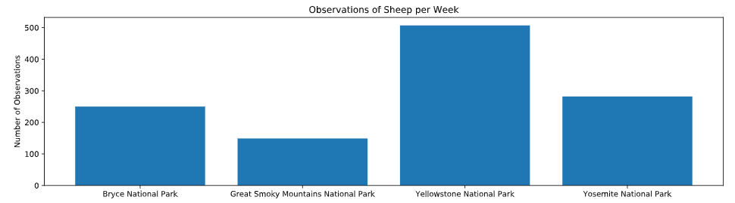
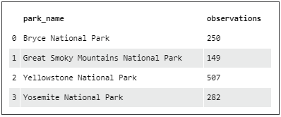
Sheep Observations
We merge together the datasets “species_info.csv” and “observations.csv” to figure out the total populations of all of the sheep across the four national parks.
Yellowstone National Park has the highest total population of sheep and Great Smoky Mountains National Park has the lowest total population of sheep.

Slide 13
Sample Size Determination
Scientists at Bryce National Park have determined that 15% of the sheep population has foot and mouth disease.
Park rangers at Yellowstone National Park are implementing a treatment program to detect foot and mouth disease.
They are hoping that they’d be able to reduce foot and mouth disease to about 10 percent.
We will be using an A/B sample size calculator to determine the sample size since the population falls into two categories: those With foot and mouth disease and those Without the disease.

Slide 14
Calculating sample size
The information we need to put into the calculator to determine sample size is:
Baseline Conversion Rate: 15%
The current rate of disease as determined by Bryce National Park.
Minimum Detectable Effect: 33.3%
Represents the change in confidence we want (from 15 to 10%, a 33.3% decrease)
Statistical Significance: 90%
Our confidence factor
Sample Size = 870

Slide 15
How Much time do we need to Test?
Yellowstone National Park
Sheep population = 507
About 12 days → (870/507) = 1.7159 weeks
Bryce National Park
Sheep population = 250
About 24 days → (870/250) = 3.48 weeks

Slide 16
THE END

